Slide 1

6th International conference on Recent Trends in Machine Learning, IOT, Smart Cities & Application (ICMISC 2025)
28-29 March 2025,
CMR Institute of Technology, Hyderabad, India
Title of Paper:- Network Intrusion Detection in VANETS Using Ma-chine Learning: Securing VANETS with Machine Learning –Based NIDS
Approach Paper ID:-
Track Name:- (Please refer the schedule)
Presenters Name & Affiliation:-
Name of All the Authors:-

Slide 2
Introduction
Imagine a hacker gaining control over traffic signals, causing accidents, or misleading autonomous vehicles into taking dangerous routes.
This is not just theoretical—it has already happened!
Example:
● In 2015, hackers remotely took control of a Jeep Cherokee, proving that vehicular networks are vulnerable.
● VANETs enable real-time vehicle communication (V2V & V2I) for road safety and traffic efficiency.
● As autonomous and connected vehicles rise, cybersecurity threats in VANETs (Vehicular Ad Hoc Networks) are a serious concern.
Key Problem: VANETs are exposed to cyber threats like Denial of Service (DoS), Sybil attacks, and Spoofing disrupt network reliability.
Our proposed solution: A Machine Learning-based Network Intrusion Detection System (NIDS) for VANET security.

Slide 3
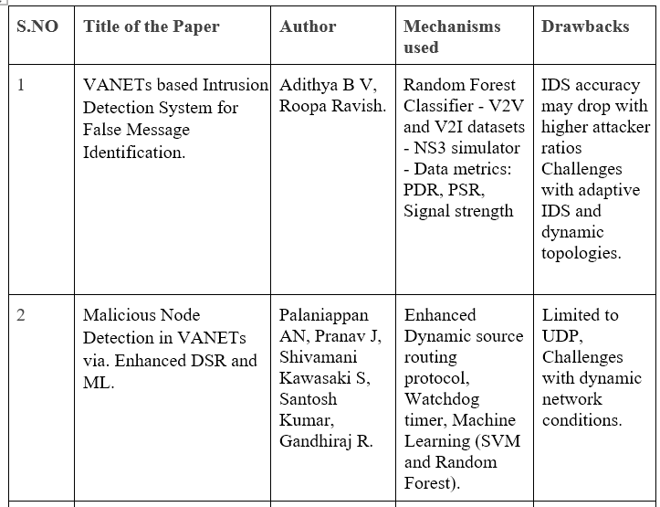
Literature Survey

Slide 4
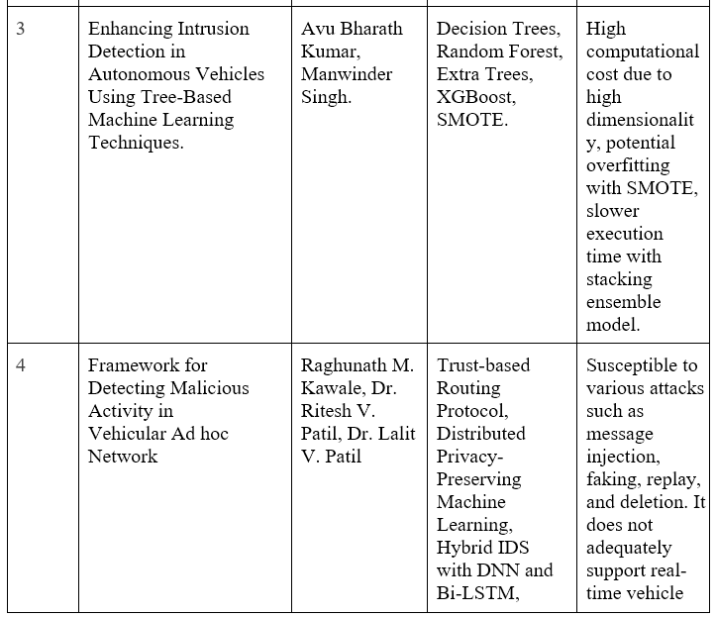
Literature Survey(CONTD…)

Slide 5
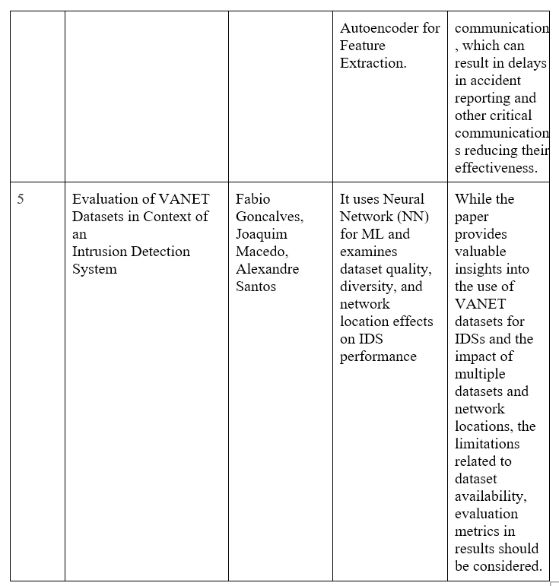
Literature Survey(CONTD…)

Slide 6
Method
Dataset Used:
- NSL-KDD Dataset – Simulated network traffic with normal and attack instances.
Machine Learning Models:
● Random Forest (RF) – Robust classification using decision trees.
● Gradient Boosting (GB) – Iterative learning for better attack detection.
● XGBoost (XGB) – High-speed, scalable attack classification.
Working Approach:
● Step 1: Preprocess data (feature selection, normalization).
● Step 2: RF, GB, and XGB are trained individually on attack detection.
● Step 3: Use ensemble learning to combine predictions and improve accuracy.
● Step 4: Real-time traffic monitoring and intrusion alert generation.

Slide 7
Result
Why Existing Solutions Fail?
Rule-Based IDS: Can only detect known attacks but fails against new threats.
Single ML Model IDS: High false positives, lower accuracy.
Heavy Computational Cost: Not optimized for real-time high-speed VANETs.
Not Scalable: Existing IDS struggle in large-scale vehicular networks.
Our Solution – What Makes Our IDS Unique?
96% Detection Accuracy – Outperforms single ML model approaches.
Real-Time Detection – Designed for fast-moving VANET environments.
Low False Positives – Ensemble learning reduces misclassification.
Detects Multiple VANET-Specific Attacks – Covers DoS, Sybil, Spoofing, Unauthorized Access, and more.
Scalable & Future-Ready – Can integrate with blockchain for enhanced security.

Slide 8
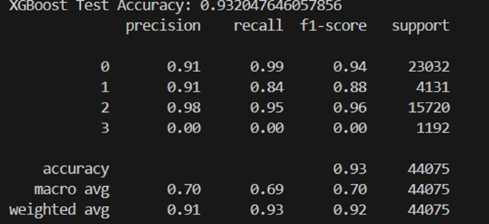
How?
Uses an ensemble of Random Forest, Gradient Boosting, and XGBoost for intelligent intrusion detection.
Deploys a real-time alert mechanism to inform vehicles & administrators about threats.
XGBoost Classifier model performance metrics

Slide 9
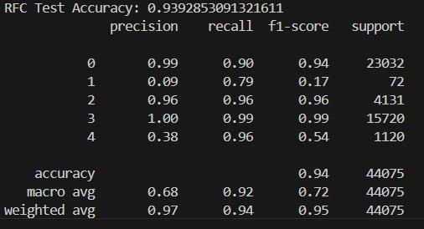
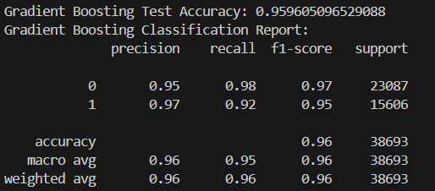
Random Forest Classifier Model Performance Metrics
Gradient Boosting Classifier Model Performance Metrics

Slide 10
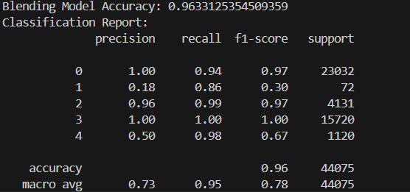
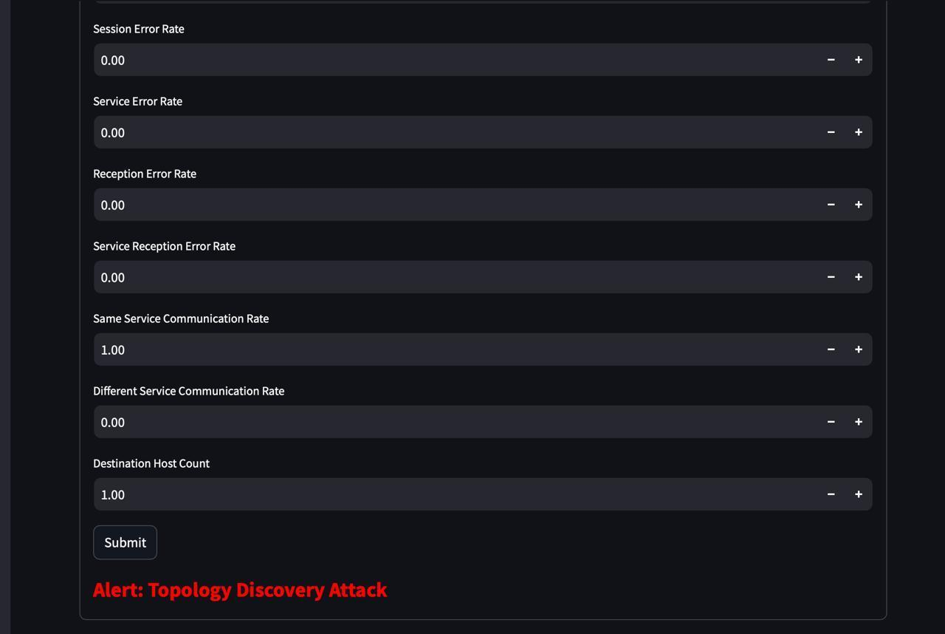
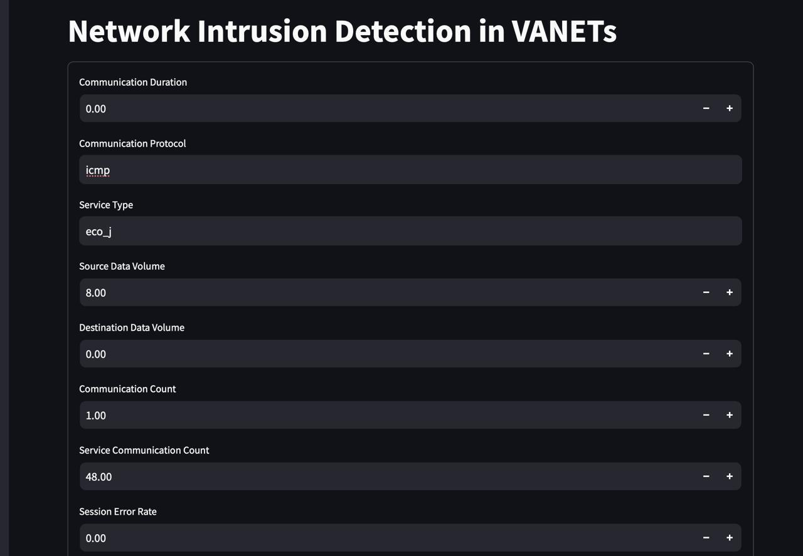
Ensemble Approach (Blending Model) Performance Metrics
Alert Message
Network Intrusion Detection System in VANETs Web Interface

Slide 11
Discussion
● Why Ensemble Learning?
- RF, GB, and XGB together enhance detection accuracy and reduce false positives.
● Advantages over Existing Systems:
- Works in real-time with high-speed vehicular communication.
- Detects both known and evolving cyber threats.
● Challenges:
- Computational complexity for real-time processing.
- Needs optimization for large-scale deployment in VANETs.

Slide 12
Future Work (If Any)
Enhancements for Real-World Deployment:
● Integration with real-time vehicular networks for live monitoring.
● Deep Learning-based IDS (CNNs, LSTMs) to improve adaptability.
● Blockchain for Security: Prevents spoofing and unauthorized message alterations.
● Edge Computing for Faster Processing: Reduces network overhead in vehicle-to-cloud communication.

Slide 13
Conclusion
● Our Work: Developed an ML-based NIDS for VANETs using an ensemble of RF, GB, and XGB.
● Key Contributions:
96% accuracy in detecting VANET attacks.
Scalable and real-time solution for smart transportation systems.
● Future Scope: Optimization for real-time vehicular deployment & integration with blockchain-based security.

Slide 14
Thank You

